Slide 1
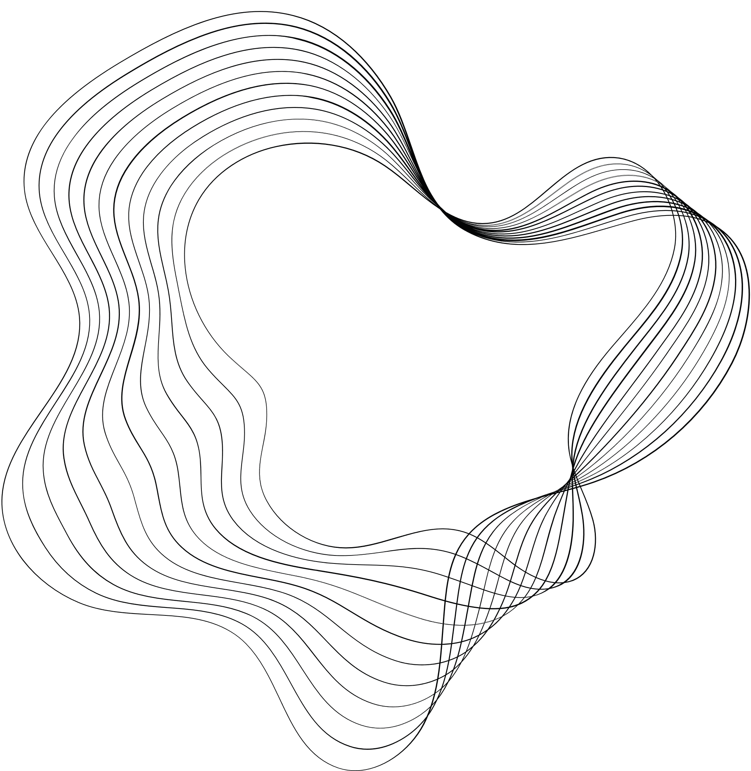

Information retrieval
PROJECT- 2024
Ariel Siman Tov & Tal Klein

Slide 2


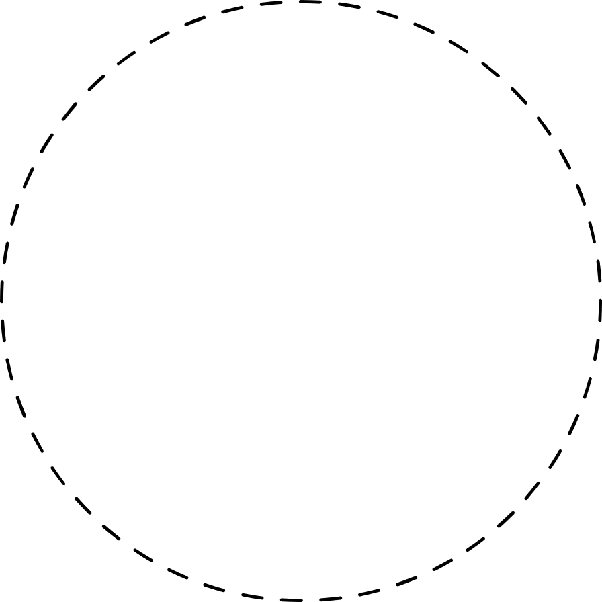


GOALS OF THE PROJECT
Building a search engine for English Wikipedia
Efficiency of minimum average retrieval time
Results quality by high harmonic mean of Precision@5 & F1@30

Slide 3


KEY EXPERIMENTS STEPS
01
02
03
04
05
06
Basic Model
Ranking Method
AVG_Time Improvement
NLP Model
Normalization
Methods
Performance Rate Improvement
Cosine similarity
+
Stemming
Change the
ranking method
to BM25
Use treads, Use Heap
data structure,
Use “Impact Ordering” by setting thresholds
Try to use
“query expansion” methods by
using Word2Vec
Try lemmatization
as an alternative
to stemming.
Stay with No stemming and no lemmatization
Adding Pageview, Improve our Tokenization,
increase the
Dictionary size
threshold

Slide 4
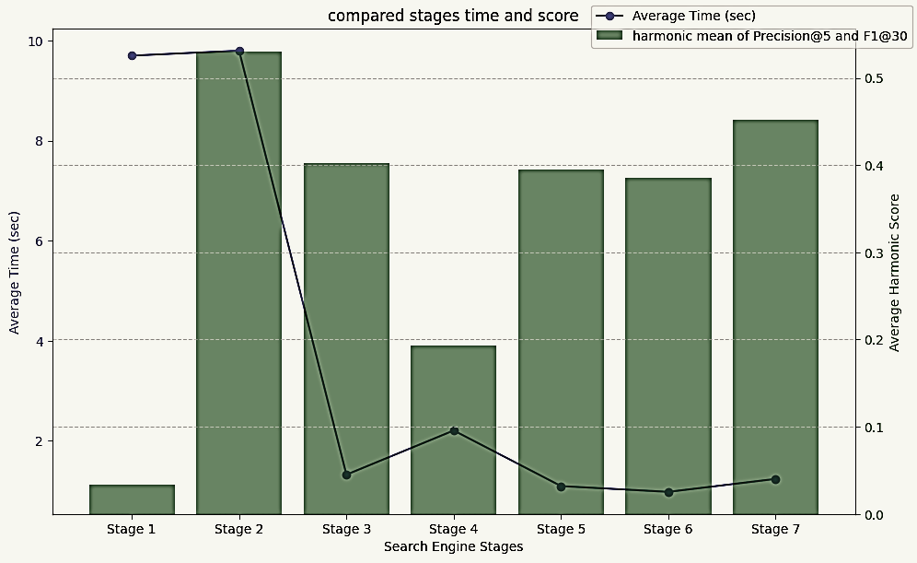

ENGINE PREFORMENCE AND RETREVAL TIME BY MAIN STEPS
FINAL
RESULTS:
AVG_Time: 1.238 | AVG_Hermonic: 0.4525 | AVG_Precision@10: 0.63

Slide 5





TAKEWAYS AND KEY FINDINGS
The choice of a ranking method significantly impacts our engine's performance.
Adopting the BM25 ranking method consistently improves our results
Optimization strategies involving multi-threading, suitable data structure (like heap) and ordering/sorting the candidate, contributed to enhanced efficiency.
NLP models, such as Word2Vec and Doc2Vec, has a big potential to improve performance, especially for case of static corpus.
Removing stemming or lemmatization in certain cases may resulted better performance.
In our understanding for two reasons: Time complexity and Evaluate method which lay mostly on precision

Slide 6

QUALITATIVE EVALUATION EXAMPELS
BAD QUERY EXAMPLE
GOOD QUERY EXAMPLE
"When did World War II end?"
Time – 3.595 | Hermonic_Score - 0.154
Our engine faced challenges because in our tokenization process, the term "II" was omitted from the query, leading to inaccuracies as the engine referred to World War in a general context, not specifically to World War II.
"Computer"
Time – 0.3243 | Hermonic_Score - 0.754
This query performs well because cumpoter is a concise and frequently used term and a widespread word across various contexts, making it easier to match within documents. Moreover, this word has general relevance and Non-Hidden-Semantic meaning which helps the retrieval.

Slide 7
THANK'S FOR YOUR LISTENING
QUSTIONS?

